Slide 1

React JS
- Santhan

Slide 2
Evolution of Frontend Web development
Composed of HTML + CSS + JS
JavaScript – To program behavior of web page
Jquery – The write less, do more JavaScript library

Slide 3
Introducing NodeJS
JavaScript run time environment
Runs on server side
JavaScript Engine – Interprets JavaScript code in browser
Node JS – Created using Google’s V8 JavaScript Engine
Extended capabilities of frontend development

Slide 4
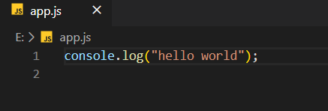
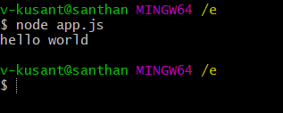
https://nodejs.org/en/download/
npm – node package manager
npm i -g create-react-app

Slide 5
ReactJS
A JavaScript library to develop user interfaces
Developed by facebook

Slide 6

JSX
JSX is a JavaScript syntax extension that looks like XML.
Concise and familiar syntax for defining tree structures with attributes.
Make large trees easier to read than function calls or object literals.
Can be used in both HTML tags and Components.

Slide 7

Document Object Model (DOM)
Tree structure representation of HTML elements

Slide 8
Virtual DOM
“virtual”, representation of a UI is kept in memory and synced with the “real” DOM

Slide 9
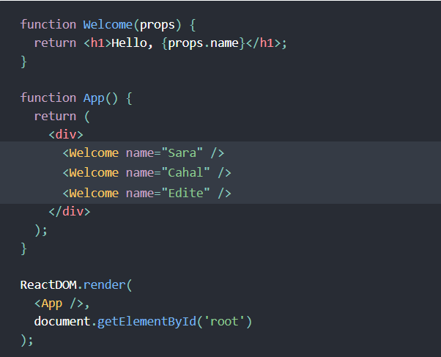
React Components
Reusable pieces of User Interface Layer

Slide 10
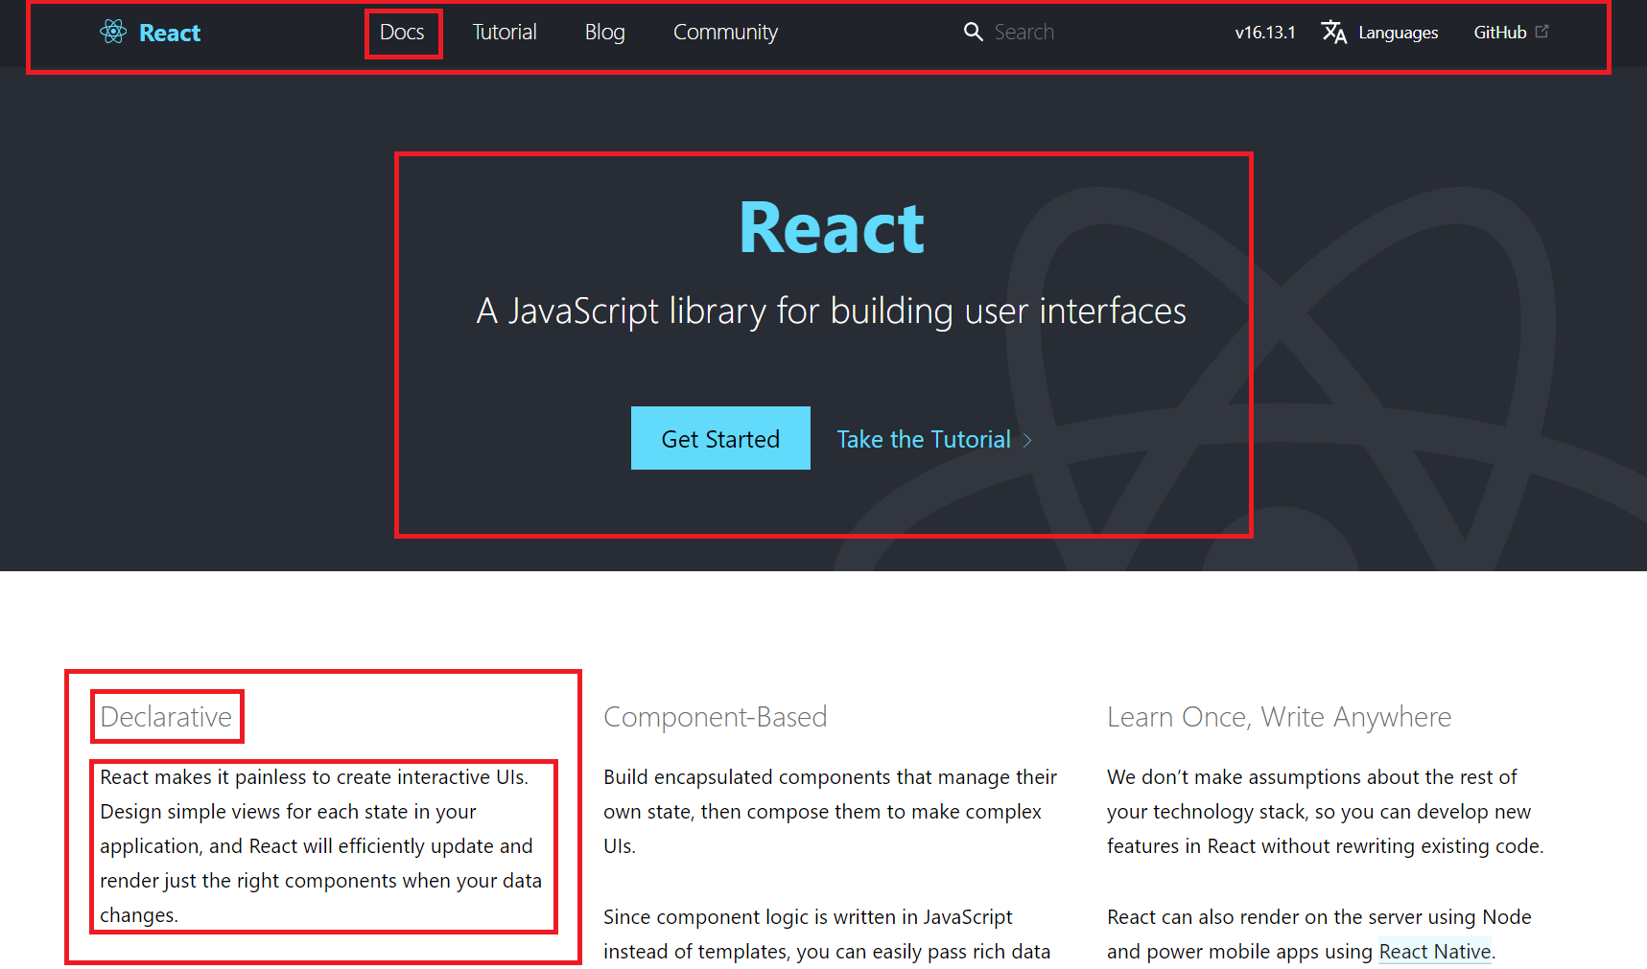
React Component
Reusable pieces of User Interface(UI) layer

Slide 11
Props (Propagates)
Arguments/Information passed (propagated) down to Components
Parent to Child
Read only

Slide 12
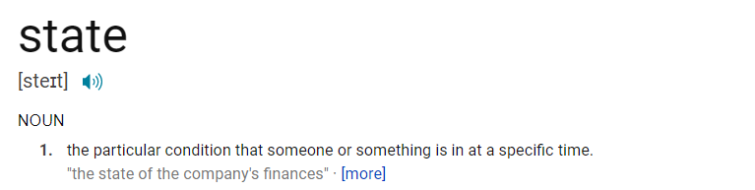
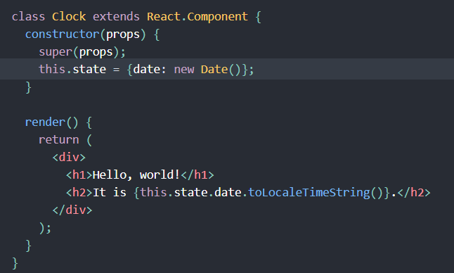
Component State
Information/data of a component at any point of time
Read/Write

Slide 13
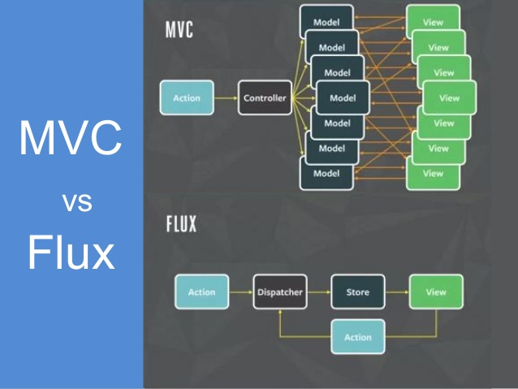
Flux Architecture

